Slide 1
The Analysis and Design of Computer Algorithms
CIS*3490 Winter 2021

Slide 2

Chapter 4
Transform and
Conquer

Slide 3

Transform and Conquer
This group of techniques solves a problem by a transformation
to a simpler/more convenient instance of the same problem (instance simplification)
to a different representation of the same instance (representation change)
to a different problem for which an algorithm is already available (problem reduction)

Slide 4
Instance simplification - Presorting
Solve a problem’s instance by transforming it into another simpler/easier instance of the same problem
Presorting
Many problems involving lists are easier when list is sorted.
searching
computing the median (selection problem)
checking if all elements are distinct (element uniqueness)

Slide 5
How fast can we sort ?
Efficiency of algorithms involving sorting depends on efficiency of sorting.
About n log₂ n comparisons are also sufficient to sort an array of size n (for example, by mergesort).

Slide 6
Searching with presorting
Problem: Search for a given K in A[0..n-1]
Presorting-based algorithm:
Stage 1 Sort the array by an efficient sorting algorithm
Stage 2 Apply binary search
Efficiency: Θ(n log n) + Θ(log n) = Θ(n log n)
Good or bad?
Why do we have our dictionaries, telephone directories, etc. sorted?

Slide 7
Element Uniqueness with presorting
Presorting-based algorithm
Stage 1: sort by efficient sorting algorithm (e.g. mergesort)
Stage 2: scan array to check pairs of adjacent elements
Efficiency: Θ(n log n) + O(n) = Θ(n log n)
Brute force algorithm Compare all pairs of elements Efficiency: O(n²)

Slide 8
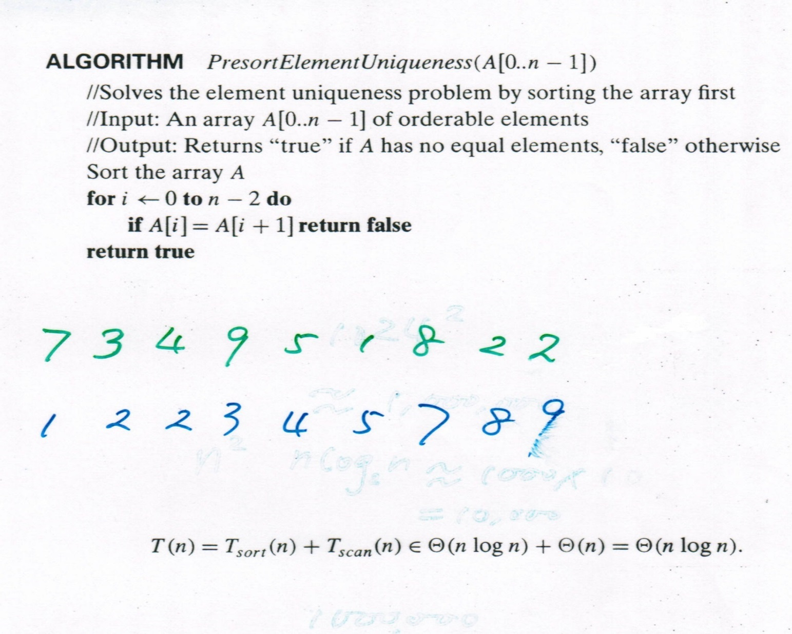
Element Uniqueness with Presorting
Example:
7 3 4 9 5 1 8 2 2
1 2 2 3 4 5 7 8 9

Slide 9
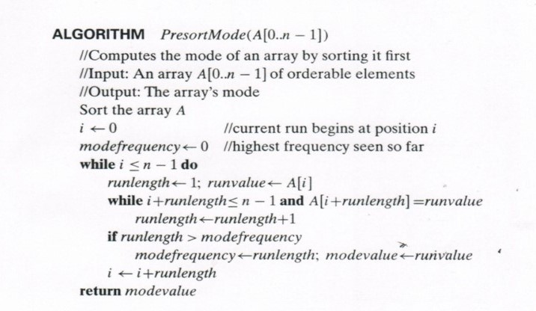
Computing the Mode with presorting
The mode is a value that occurs most often in a given list of numbers.
A brute force algorithm is to create a separate list A’ to store the frequencies of numbers in list A.
For each number in list A, the algorithm checks A’ and update the frequency of the number.
Example:
A: 5 3 7 2 3 5 1 5
A’: 5 3 7 2 1
||| || | | |
The cost of this algorithm is Θ(n²).
Example:
A: 5 3 7 2 3 5 1 5
A’’: 1 2 3 3 5 5 5 7
The cost of this algorithm is
Θ(n log n) + O(log n) = Θ(n log n)

Slide 10
Instance simplification – Gaussian Elimination
Given: A system of n linear equations in n unknowns with an arbitrary coefficient matrix. Transform to: An equivalent system of n linear equations in n unknowns with an upper triangular coefficient matrix. Solve the latter by substitutions starting with the last equation and moving up to the first one. a₁₁x₁ + a₁₂x₂ + … + a_{1n}x_{n} = b₁ a_{1,1}x₁+ a₁₂x₂ + … + a_{1n}x_{n} = b₁
a₂₁x₁ + a₂₂x₂ + … + a_{2n}x_{n} = b₂ a₂₂x₂ + … + a_{2n}x_{n} = b₂
… … … …
a_{n1}x₁ + a_{n2}x₂ + … + a_{nn}x_{n} = b_{n} a_{nn}x_{n} = b_{n}

Slide 11
Gaussian Elimination (cont.)
The transformation is accomplished by a sequence of elementary operations on the system’s coefficient matrix (which don’t change the system’s solution): for i ←1 to n-1 do replace each of the subsequent rows (i.e., rows i+1, …, n) by a difference between that row and an appropriate multiple of the i-th row to make the new coefficient in the i-th column of that row 0

Slide 12
Example of Gaussian Elimination
Gaussian elimination
2 -4 1 6 2 -4 1 6
3 -1 1 11 row2 – (3/2)*row1 0 5 -1/2 2
1 1 -1 -3 row3 – (1/2)*row1 0 3 -3/2 -6 row3–(3/5)*row2
2 -4 1 6
0 5 -1/2 2
0 0 -6/5 -36/5
Backward substitution
x₃ = (-36/5) / (-6/5) = 6
x₂ = (2+(1/2)*6) / 5 = 1
x₁ = (6 – 6 + 4*1)/2 = 2
Solve 2x₁ - 4x₂ + x₃ = 6 3x₁ - x₂ + x₃ = 11 x₁ + x₂ - x₃ = -3

Slide 13
Gaussian Elimination
Stage 1: Reduction to the upper-triangular matrix
for i ← 1 to n-1 do for j ← i+1 to n do for k ← i to n+1 do A[j, k] ← A[j, k] - A[i, k] * A[j, i] / A[i, i]
Stage 2: Backward substitution for j ← n downto 1 do t ← 0 for k ← j +1 to n do t ← t + A[j, k] * x[k] x[j] ← (A[j, n+1] - t) / A[j, j]
Efficiency: Θ(n³) + Θ(n²) = Θ(n³)

Slide 14
Taxonomy of Searching Algorithms
List searching
sequential search
binary search
Tree searching
binary search tree
binary balanced trees: AVL trees, red-black trees
multiway balanced trees: 2-3 trees, 2-3-4 trees, B trees
Hashing
open hashing (separate chaining)
closed hashing (open addressing)

Slide 15
Binary Search Tree
Arrange keys in a binary tree with the binary search tree property:
K
<K
>K

Slide 16
Dictionary Operations on Binary Search Trees
Searching – straightforward
Insertion – search for key, insert at leaf where search terminated
Deletion – 3 cases:
deleting key at a leaf
deleting key at node with single child
deleting key at node with two children
Efficiency depends of the tree’s height: ⎣log₂ n⎦ ≤ h ≤ n-1, with height average (random files) be Θ(log n)
Thus all three operations have
worst case efficiency: Θ(n)
average case efficiency: Θ(log n)
Notes:
1.41 lg n = 2 ln n

Slide 17
Dictionary Operations on Binary Search Trees
Insertion – search for key, insert at leaf where search terminated.
Example: inserting 11
8
8
5
9
5
9
3
6
3
6
11
2
4
2
4
Notes:
1.41 lg n = 2 ln n

Slide 18
Dictionary Operations on Binary Search Trees
Deleting key at a leaf – delete the node.
Example: deleting 4
8
8
5
9
5
9
3
6
11
3
6
11
2
4
2
Notes:
1.41 lg n = 2 ln n

Slide 19
Dictionary Operations on Binary Search Trees
Deleting key at a node with single child – replace the node with the child.
Example: deleting 9
8
8
5
9
5
11
3
6
11
3
6
2
4
2
Notes:
1.41 lg n = 2 ln n

Slide 20
Dictionary Operations on Binary Search Trees
Deleting key at a node with two children – replace the node with the node of in-order successor.
Example: deleting 5
8
8
5
9
6
11
3
6
11
3
2
4
2
4
Notes:
1.41 lg n = 2 ln n

Slide 21
Balanced Search Trees
Attractiveness of binary search tree is marred by the bad (linear) worst-case efficiency. Two ideas to overcome it are:
to rebalance binary search tree when a new insertion makes the tree “too unbalanced”
AVL trees
red-black trees
to allow more than one key per node of a search tree
2-3 trees
2-3-4 trees
B-trees

Slide 22
Balanced Trees: AVL trees
Definition An AVL tree is a binary search tree, in which, for every node, the difference between the heights of its left and right subtrees, called the balance factor, is at most 1 (with the height of an empty tree defined as -1)
Tree (a) is an AVL tree; tree (b) is not an AVL tree

Slide 23
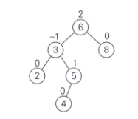
Rotations
If a key insertion violates the balance requirement at some node, the sub-tree rooted at that node is transformed via one of the four rotations. (The rotation is always performed for a subtree rooted at an “unbalanced” node closest to the new leaf.)
To re-balance an AVL tree, we travel up the tree from the newly inserted node until we find the first node such that its balance factor is -2 or 2. We label the node with X.
Check heights of the two sub-trees of X, and label the root of the higher sub-tree as Y.
Check heights of the two sub-trees of Y, and label the root of the higher sub-tree as Z.
Then choose the type of rotation based on the left-right relationships of X-Y-Z.
There are four types of rotations: single L-rotation, single R-rotation, double LR rotation, double RL rotation.
X
Y
Z

Slide 24
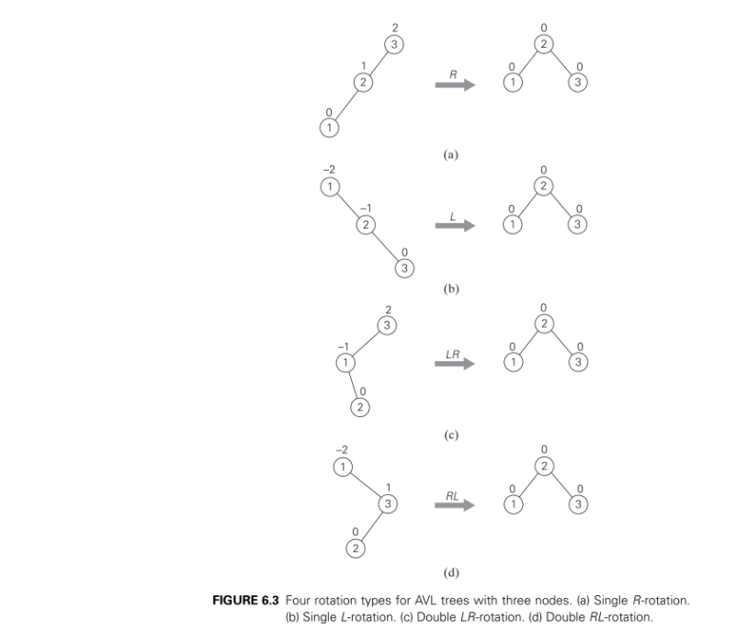
Four Types of Rotations (Simplest Cases)
X
Y
Z
X
Y
Z
3
X
2
Y
1
Z
1
X
2
Y
3
Z

Slide 25
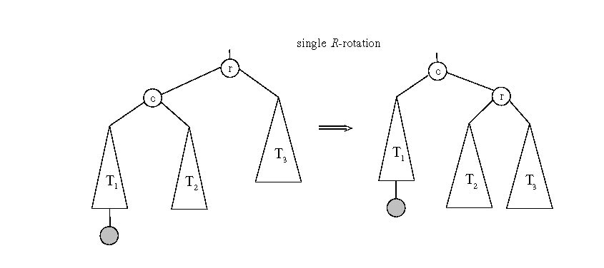
General Case: Single R-rotation
X
Y
Z

Slide 26
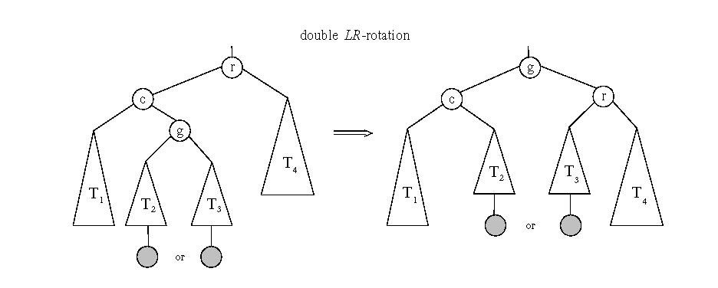
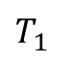



General case: Double LR-rotation
X
Y
Z
r
g
c
$$T_{3}$$
$$T_{4}$$
$$T_{1}$$
$$T_{2}$$

Slide 27
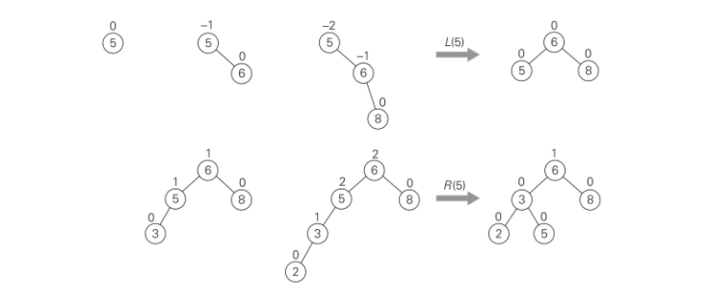
AVL tree construction - an example
Construct an AVL tree for the list 5, 6, 8, 3, 2, 4, 7
X
Y
Z
X
Y
Z

Slide 28
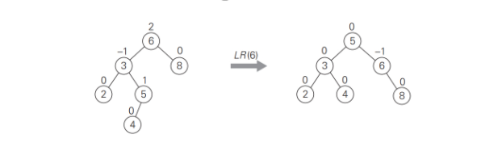
AVL tree construction - an example (cont.)
Construct an AVL tree for the list 5, 6, 8, 3, 2, 4, 7
X
Y
Z
6
5
8
3
2
4

Slide 29
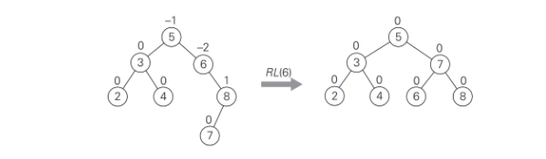
AVL tree construction - an example (cont.)
Construct an AVL tree for the list 5, 6, 8, 3, 2, 4, 7
X
Y
Z
5
3
6
2
4
7
8

Slide 30
Analysis of AVL trees
h ≤ 1.4404 log₂ (n + 2) - 1.3277
average height: 1.01 log₂n + 0.1 for large n (found empirically)
Search and insertion are O(log n)
Deletion is more complicated but is also O(log n)
Disadvantages:
frequent rotations
complexity

Slide 31
Multiway Search Trees
Definition A multiway search tree is a search tree that allows more than one key in the same node of the tree.
Definition A node of a search tree is called an n-node if it contains n-1 ordered keys (which divide the entire key range into n intervals pointed to by the node’s n links to its children):
Note: Every node in a classical binary search tree is a 2-node
k₁ < k₂ < … < k_{n-1}
< k₁
[k₁, k₂ )
≥ k_{n-1}

Slide 32
2-3 Tree
Definition A 2-3 tree is a search tree that
may have 2-nodes and 3-nodes
height-balanced (all leaves are on the same level)
A 2-3 tree is constructed by successive insertions of keys given, with a new key always inserted into a leaf of the tree. If the leaf is a 3-node, it’s split into two with the middle key promoted to the parent.

Slide 33
2-3 tree construction – an example
Construct a 2-3 tree the list 9, 5, 8, 3, 2, 4, 7

Slide 34
Analysis of 2-3 trees
log₃ (n + 1) - 1 ≤ h ≤ log₂ (n + 1) - 1
Search, insertion, and deletion are in Θ(log n)
The idea of 2-3 tree can be generalized by allowing more keys per node
2-3-4 trees
B-trees

Slide 35
Heaps and Heapsort
Definition: A heap is a binary tree with keys at its nodes (one key per node) such that:
It is essentially complete, i.e., all its levels are full except possibly the last level, where only some rightmost keys may be missing
The key at each node is ≥ keys at its children

Slide 36
Illustration of the heap’s definition
a heap
not a heap
not a heap
Note: Heap’s elements are ordered top down (along any path down from its root), but they are not ordered left to right

Slide 37
Some Important Properties of a Heap
Given n, there exists a unique binary tree with n nodes that is essentially complete, with h = ⎣log₂ n⎦
The root contains the largest key
A heap can be represented as an array
The subtree rooted at any node of a heap is also a heap

Slide 38
Heap’s Array Representation
Store heap’s elements in an array (whose elements indexed, for convenience, 1 to n) in top-down left-right order
Example:
Left child of node j is at 2j
Right child of node j is at 2j+1
Parent of node j is at ⎣j/2⎦
Parental nodes are represented in the first ⎣n/2⎦ locations
9
1 2 3 4 5 6
5
3
9 5 3 1 4 2
1
4
2

Slide 39
The Downheap Operation
The downheap operation is performed on a parental node.
When downheap is performed on a node, the operation keeps exchanging the node with its largest child until the heap condition holds.
Downheap is useful in heap construction, heapsorting, and deletion of the root.
Efficiency: log n
8
8
5
7
6
7
6
2
3
5
2
3

Slide 40
Example of Heap Construction
Construct a heap for the list 2, 9, 7, 6, 5, 8
Fill the binary tree top-down, left-right with the keys
Apply downheap to the last parental node, the second last parental node, … the root node.
1
2
3
4
5

Slide 41
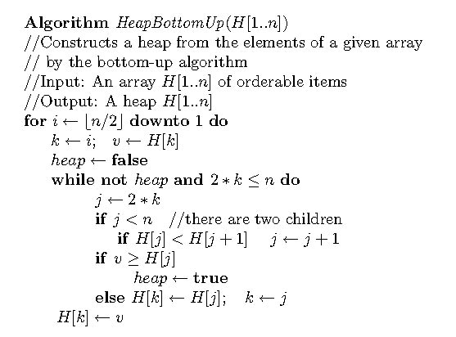
Bottom-up Heap Construction

Slide 42
Heapsort
Stage 1: Construct a heap for a given list of n keys
Stage 2: Repeat operation of root removal n-1 times:
Exchange keys in the root and in the last (rightmost) leaf
Decrease heap size by 1
If necessary, swap new root with larger child until the heap condition holds by using the downheap method

Slide 43
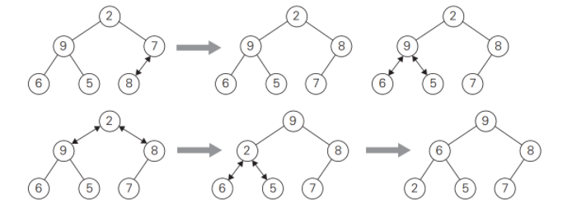
Example of Sorting by Heapsort
Sort the list 2, 9, 7, 6, 5, 8 by heapsort
Stage 1 (heap construction)
2 9 7 6 5 8 9 6 8 2 5 7
2 9 8 6 5 7 7 6 8 2 5 | 9
2 9 8 6 5 7 8 6 7 2 5 | 9
9 2 8 6 5 7 5 6 7 2 | 8 9
9 6 8 2 5 7 7 6 5 2 | 8 9
1
2
3
4
5

Slide 44
Example of Sorting by Heapsort
Sort the list 2, 9, 7, 6, 5, 8 by heapsort
Stage 2 (root/max removal)
9 6 8 2 5 7
7 6 8 2 5 | 9
8 6 7 2 5 | 9
5 6 7 2 | 8 9
7 6 5 2 | 8 9
2 6 5 | 7 8 9
6 2 5 | 7 8 9
5 2 | 6 7 8 9
5 2 | 6 7 8 9
2 | 5 6 7 8 9
9
Max removal
7
Downheap
8
Max removal
5
6
8
6
8
6
7
6
7
2
5
7
2
5
9
2
5
9
2
8
9
Downheap
7
Max removal
2
Downheap
6
Max removal
6
5
6
5
2
5
2
8
9
7
8
9
7
8
9
5
Max removal
2
Max removal
2
2
6
5
6
5
6
7
8
9
7
8
9
7
8
9

Slide 45
Example of Sorting by Heapsort
Sort the list 2, 9, 7, 6, 5, 8 by heapsort
Stage 2 (root/max removal)
9 6 8 2 5 7
7 6 8 2 5 | 9
8 6 7 2 5 | 9
5 6 7 2 | 8 9
7 6 5 2 | 8 9
2 6 5 | 7 8 9
6 2 5 | 7 8 9
5 2 | 6 7 8 9
5 2 | 6 7 8 9
2 | 5 6 7 8 9
9
Max removal
7
Downheap
8
Max removal
5
6
8
6
8
6
7
6
7
2
5
7
2
5
9
2
5
9
2
8
9
Downheap
7
Max removal
2
Downheap
6
Max removal
6
5
6
5
2
5
2
8
9
7
8
9
7
8
9
5
Max removal
2
Max removal
2
2
6
5
6
5
6
7
8
9
7
8
9
7
8
9

Slide 46
Analysis of Heapsort
Stage 1: Build heap for a given list of n keys
worst-case
C(n) =
Stage 2: Repeat operation of root removal n-1 times (fix heap)
worst-case
C(n) =
Both worst-case and average-case efficiency: Θ(n log n) In-place: yes
h-1
Σ
2(h-i) 2^{i} = 2 ( n – log₂(n + 1)) ∈ Θ(n)
i=0
# nodes at level i
n-1
Σ
2log₂ i ∈ Θ(nlogn)
i=1

Slide 47
Priority Queue
A priority queue is the ADT of a set of elements with numerical priorities with the following operations:
find element with highest priority
delete element with highest priority
insert element with assigned priority (see below)
Heap is a very efficient way for implementing priority queues
Two ways to handle priority queue in which highest priority = largest number, or highest priority = smallest number

Slide 48
The Upheap Operation and Adding a Node
The upheap operation is performed on a leaf node.
When upheap is performed on a node, the operation keeps exchanging the node with its parent until the heap condition holds.
Upheap is useful when a new node is added to a heap.
Efficiency: log n
8
8
9
6
7
6
9
6
8
5
2
3
9
5
2
3
7
5
2
3
7

Slide 49
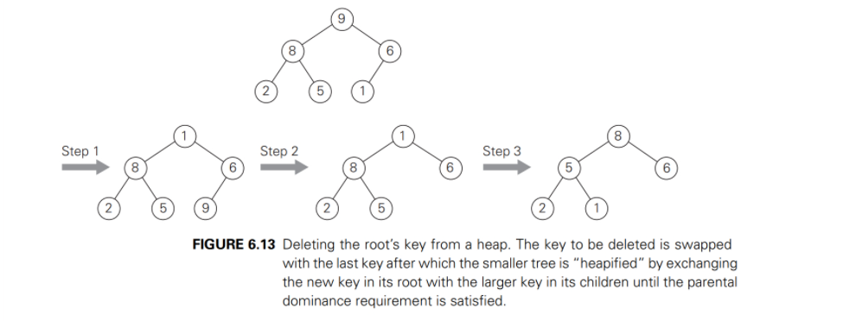
Delete the Root from a Heap

Slide 50
Horner’s Rule For Polynomial Evaluation
Given a polynomial of degree n
p(x) = a_{n}x^{n} + a_{n-1}x^{n-1} + … + a₁x + a₀
and a specific value of x, find the value of p at that point.
Two brute-force algorithms:
p ← 0 p ← a₀; power ← 1
for i ← n downto 0 do for i ← 1 to n do
power ← 1 power ← power * x
for j ← 1 to i do p ← p + a_{i} * power
power ← power * x return p
p ← p + a_{i} * power
return p

Slide 51
Horner’s Rule
Example: p(x) = 2x⁴ - x³ + 3x² + x - 5
= x(2x³ - x² + 3x + 1) - 5
= x(x(2x² - x + 3) + 1) - 5
= x(x(x(2x - 1) + 3) + 1) - 5
= x(x(x(x(2) - 1) + 3) + 1) - 5
Substitution into the last formula leads to a faster algorithm
Same sequence of computations are obtained by simply arranging the coefficient in a table and proceeding as follows:
coefficients 2 -1 3 1 -5
x=3 2 3*2-1=5 3*5+3=18 3*18+1=55 3*55-5=160

Slide 52
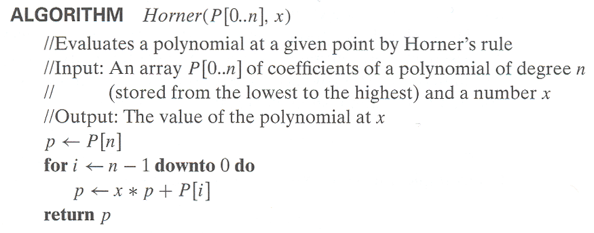
Horner’s Rule pseudocode
Efficiency of Horner’s Rule: # multiplications = # additions = n

Slide 53

Computing a^{n}
Left-to-right binary exponentiation
Initialize product accumulator by 1.
Scan n’s binary expansion from left to right and do the following:
If the current binary digit is 0, square the accumulator (S); if the binary digit is 1, square the accumulator and multiply it by a (SM).
Example: Compute a¹³. Here, n = 13 = 1101₂. binary rep. of 13: 1 1 0 1 SM SM S SM accumulator: 1 1²*a=a a²*a = a³ (a³)² = a⁶ (a⁶)²*a= a¹³ (computed left-to-right) Efficiency: (b-1) ≤ M(n) ≤ 2(b-1) where b = ⎣log₂ n⎦ + 1, M(n) $∈$ Θ(log n)

Slide 54

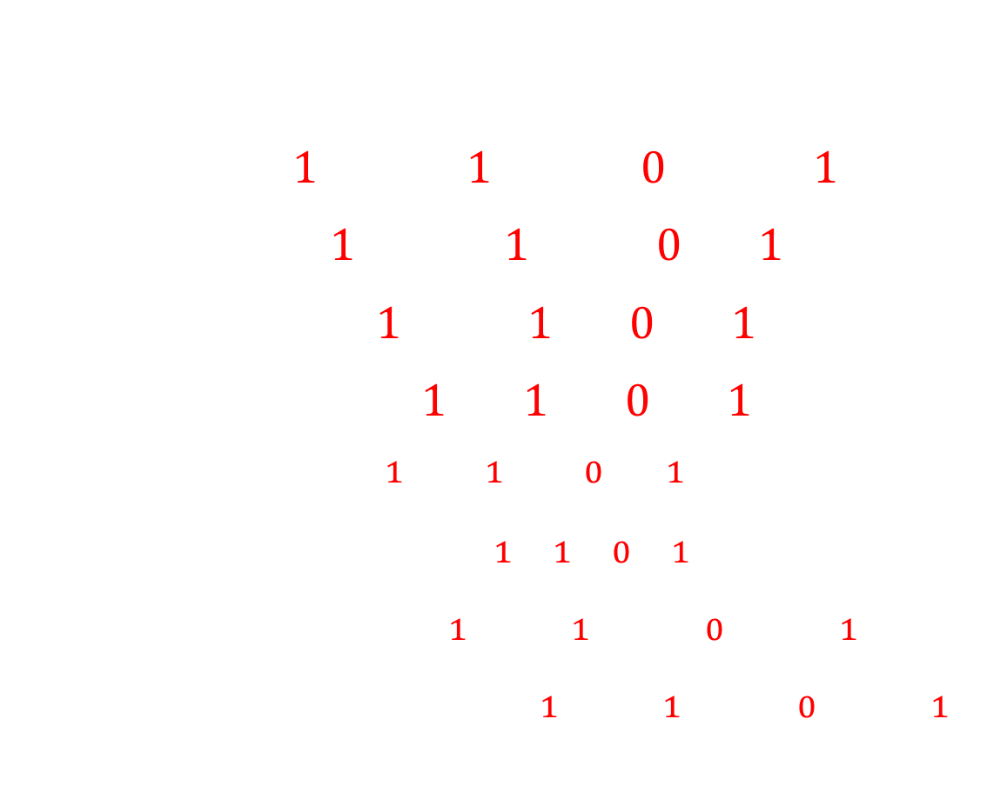
Computing a^{n}
13 = 1101₂
$$13=1∗2^{3}+1∗2^{2}+0∗2^{1}+1$$
$=2\left(1∗2^{2}+1∗2+0\right)+1$
$=2\left(2(1∗2+1)+0\right)+1$
$=2\left(2(2(1)+1)+0\right)+1$
$a^{{13}_{10}}$ = $a^{{1101}_{2}}=a^{1∗2^{3}+1∗2^{2}+0∗2+1}$
$=a^{2(2(2(1)+1)+0)+1}$
$={(((a^{1})}^{2}∗a^{1})^{2}∗a^{0})^{2}∗a^{1}$
$={(((1^{2}{∗a}^{1})}^{2}∗a^{1})^{2}∗a^{0})^{2}∗a^{1}$
$${(b}^{x})^{y}=b^{x∗y}$$
$$b^{u}∗b^{v}=b^{u+v}$$
$$b^{w(z)}=(b^{z})^{w}$$

Slide 55
Design techniques and problem types
 | Search | Sorting | Tree | Graph | Other
Brute force, exhaustive search | Sequential search, Sequential string match | Selection sort, Bubble sort |  | Traveling salesman problem, DFS, BFS | Knapsack problem, Assignment problem
Decrease and conquer | Binary search | Insertion sort | Binary search tree | Topological sorting | Exponentiation by squaring
Divide and conquer |  | Mergesort, Quicksort | Binary tree traversal |  | Matrix multiplication, Large integer multiplication, quickhull
Transform and conquer | Presorting | Heapsort, priority queue | AVL tree, 2-3 tree |  | Gaussian elimination, Polynomial evaluation
Space and time tradeoff | Hashing, B-tree, Horspool algorithm | Sorting by counting
Dynamic programming |  |  | Optimal binary search trees | Warshall’s algorithm, Shortest paths problem | Knapsack problem, Memory functions
Greedy techniques |  |  |  | Minimum spanning tree | Huffman trees
Iterative improvement |  |  |  | Maximum flow Bipartite graphs | Stable marriage problem
Backtracking Branch & bound |  |  |  | Traveling salesman problem, | N-queens, Assignment, Knapsack

Slide 56
Recommended Reading
6.1
6.2
6.3
6.4
6.5

